Slide 1

Proofs
By Ariel Avshalom
Lecture 2: examples of direct proofs
CISC 2210

Slide 2


If x is an odd integer, then $x^{3}$ is odd.
Let x = 2n+1 for $∀n ∈\text{ℤ}$
Then
$$x^{3}={\left(2n+1\right)}^{3}$$
$$=8n^{3}+12n^{2}+6n+1$$
$$=2\left(4n^{3}+6n^{2}+3n\right)+1$$
Which is of the form 2n+1
Q.E.D.

Slide 3

Suppose x, y ∈ Z. If x and y are odd, then xy is odd.
Let x = 2n+1, y = 2m+1 for $∀n,m ∈\text{ℤ}$
Then
$$xy= (2n+1)(2m+1)$$
$$=4nm+2n+2m+1$$
$$=2\left(2nm+n+m\right)+1$$
Which is of the form 2n + 1
Q.E.D.

Slide 4
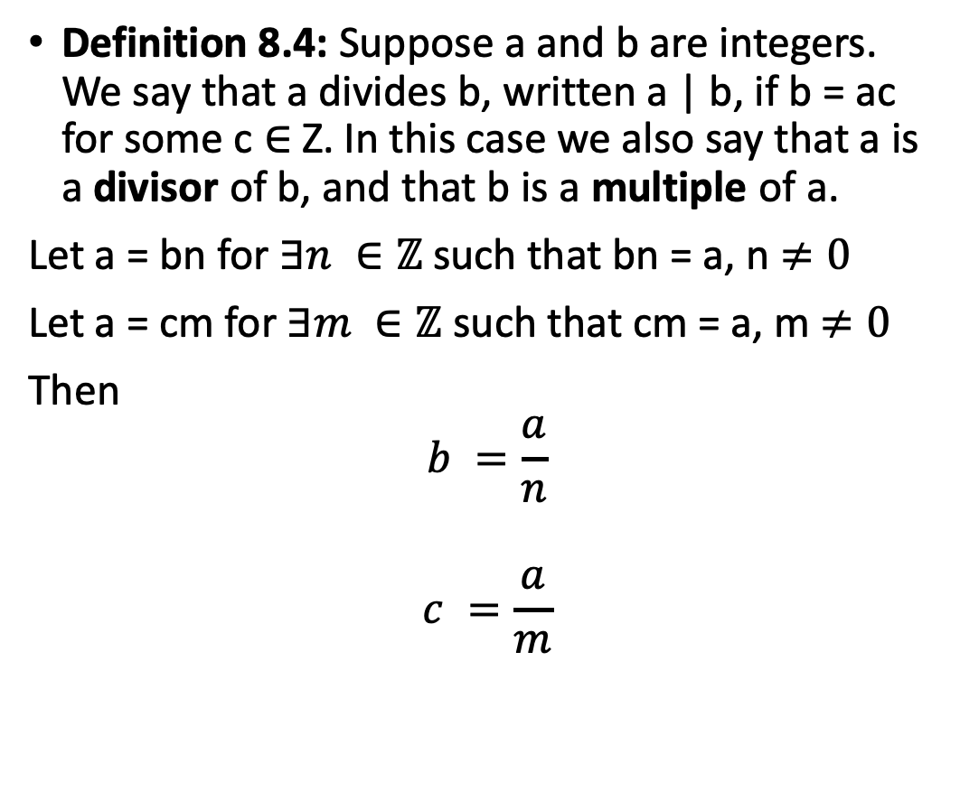
Suppose a,b, c ∈ Z. If a | b and a | c, then a | (b + c).
Definition 8.4: Suppose a and b are integers. We say that a divides b, written a | b, if b = ac for some c ∈ Z. In this case we also say that a is a divisor of b, and that b is a multiple of a.
Let a = bn for $∃n ∈\text{ℤ}$ such that bn = a, n $≠0$
Let a = cm for $∃m ∈\text{ℤ}$ such that cm = a, m $≠0$
Then
$$b =\frac{a}{n}$$
$$c =\frac{a}{m}$$

Slide 5

Continued
$$b+c=\frac{a}{n}+\frac{a}{m}=a(\frac{1}{n}+\frac{1}{m})$$
And
$$A | (b+c)$$
Since a is a common multiple between b + c

Slide 6

Suppose a is an integer. If 5|2a, then 5|a.
If
$$5 | 2a$$
Then
$$5|2 or 5|a$$
Since
$$5\text{∤}\text{2}$$
Then
$$5 | a$$
Q.E.D.

Slide 7

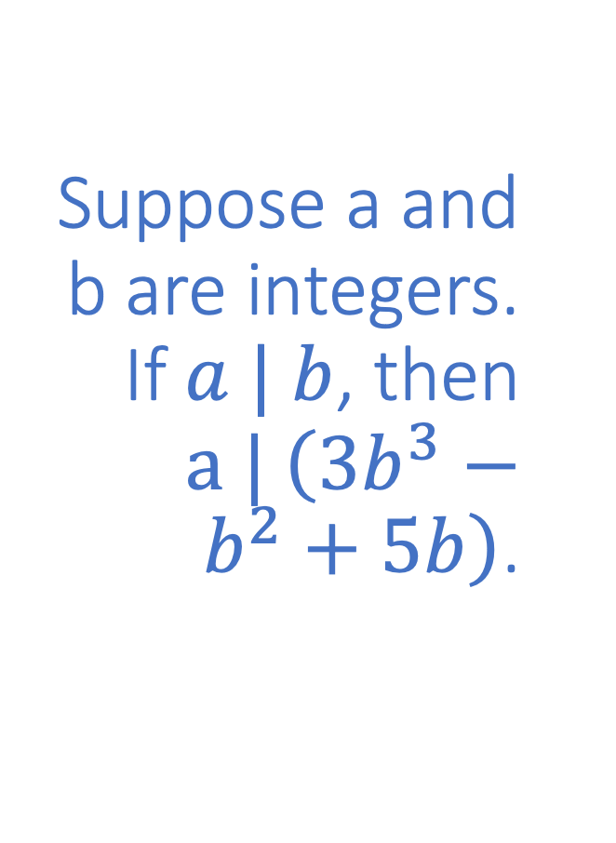
Suppose a and b are integers. If $a | b$, then $a | \left(3b^{3}−b^{2}+5b\right)$.
$$\left(3b^{3}−b^{2}+5b\right)=b\left(3b^{2}−b^{1}+5\right)$$
Since
$$a | b$$
Then
$$a | b\left(3b^{2}−b^{1}+5\right)$$
Because
They share the common multiple b.

Slide 8
Using cases in proofs:
In proving a statement is true, we usually examine multiple cases before showing the statement is true in all possible scenarios.
This means we need to differentiate between possibly differing results depending on the proposition being proved

Slide 9
Example: parity
In general, integers can be split to even and odd values. Sometimes different cases can produce different results so generally you need to prove both.
Sometimes some cases are so similar to each other, that writing out both is meaningless, like
If two integers have opposite parity, then their sum is odd
The cases here are switching the positions of the even and odd integers and there is no reason to do so.
You can write without loss of generality to indicate that additional cases do not provide anything useful
Here is an example where cases do matter:

Slide 10
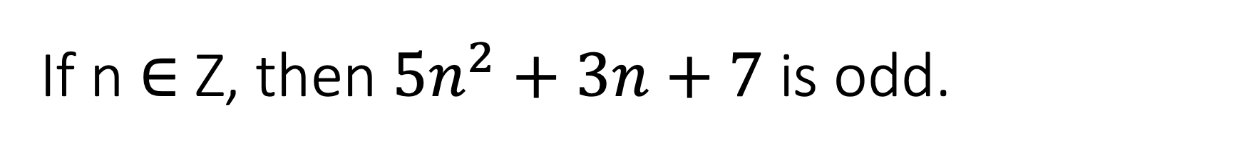
If n ∈ Z, then $5n^{2}+3n+7$ is odd.

